Slide 1
10718 Assignment 1
Proposal and Data Exploration
Team: Maitreyi Swaroop, Sukjun Hwang, Fahim Tajwar

Slide 2
Problem Statement
Core question: Does pretraining perplexity predict downstream task performance in genomic language models?
Approach: Pretrain DNA language models on the human reference genome (HG38). Evaluate on enhancer/promoter prediction tasks
Why it matters: Determines if perplexity is a meaningful metric for genomic model development
References: https://www.ncbi.nlm.nih.gov/datasets/genome/GCF_000001405.26/
Notes:
Alt framings: Characterize when (and whether) pretraining loss is a reliable proxy for downstream utility
Need a succinct

Slide 3
Dataset overview
Dataset
Format
PRETRAINING: HG38
Human reference genome - consensus human DNA sequence.
25 genome sequences
(Chr1-22, X,Y,M)
Seq of {A,C,G,T,N}, length O(10^8)
TASK 1:
Enhancer Classification
Binary classification dataset to predict whether a DNA sequence is an enhancer i.e. regulatory element that increases gene transcription
14,968 training, and 400 test sequences of {A,C,G,T,N}^200
Baseline test accuracy 50% (even split)
TASK 2:
Promoter Classification
Binary classification dataset to predict the presence of a promoter element (regions where RNA polymerase binds to initiate transcription) in a DNA sequence
53,276 training, and 5,920 test sequences of {A,C,G,T,N}^300
Baseline test accuracy 50% (even split)
Data sources: UCSC repo; Huggingface

Slide 4
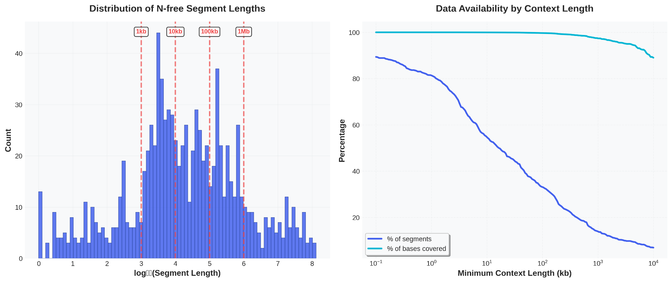
Preprocessing: missingness in HG38
‘N’s indicate unsequenced/ambiguous regions in the reference genome (~5% of bases)
Approach: Split genome on N-gaps, discard Ns, chunk N-free segments into fixed-length windows (standard practice*)
Implications: Negligible data loss from masking Ns/chunking; >90% of genome bases remain usable even at large contexts; not a concern at our 200–300bp downstream task lengths
References: *DNABERT, HyenaDNA, Nucleotide Transformer
Notes:
The regular human genome is A-T rich (not uniformly distributed). If the bases were independently sampled at random, each occur about ~25% of the time - a trivial model that learns base frequencies can do better than random guessing.
For the eval datasets, plots are for the test samples; lighter colour is Y=0; darker for Y=1
- For 2nd row, plots are for Y=1 only, I also have plots of the difference if needed
2nd metric Shows how much learnable structure exists beyond single-base frequencies (this may fit better in comparison with the promoter dataset - since promoter sites have more CG clusters)

Slide 5
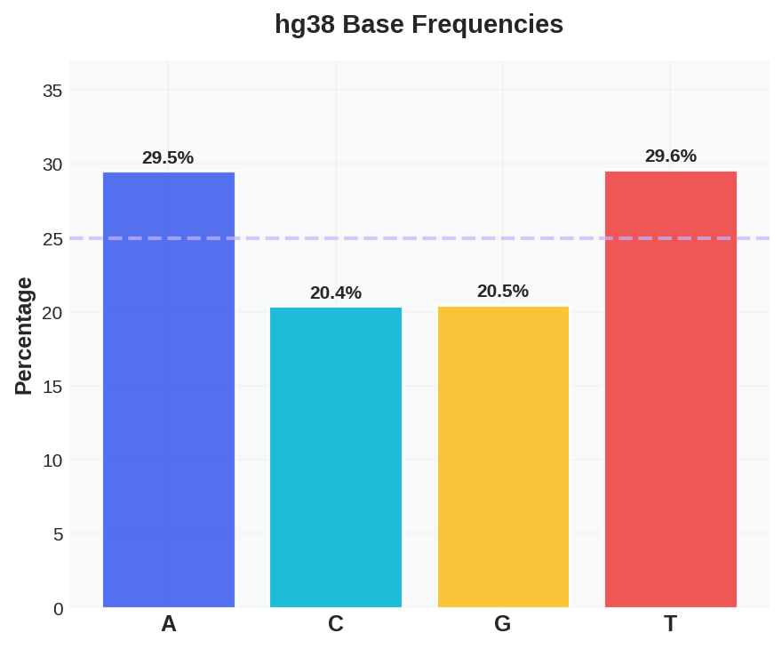
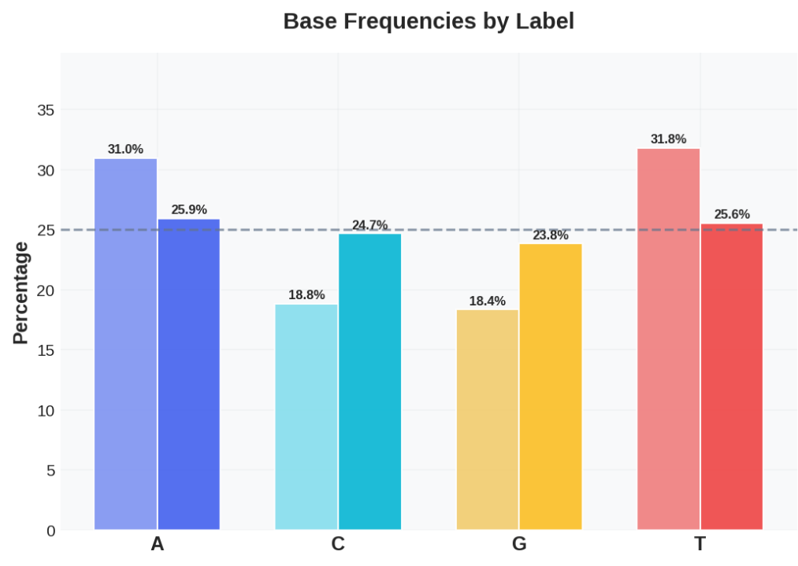
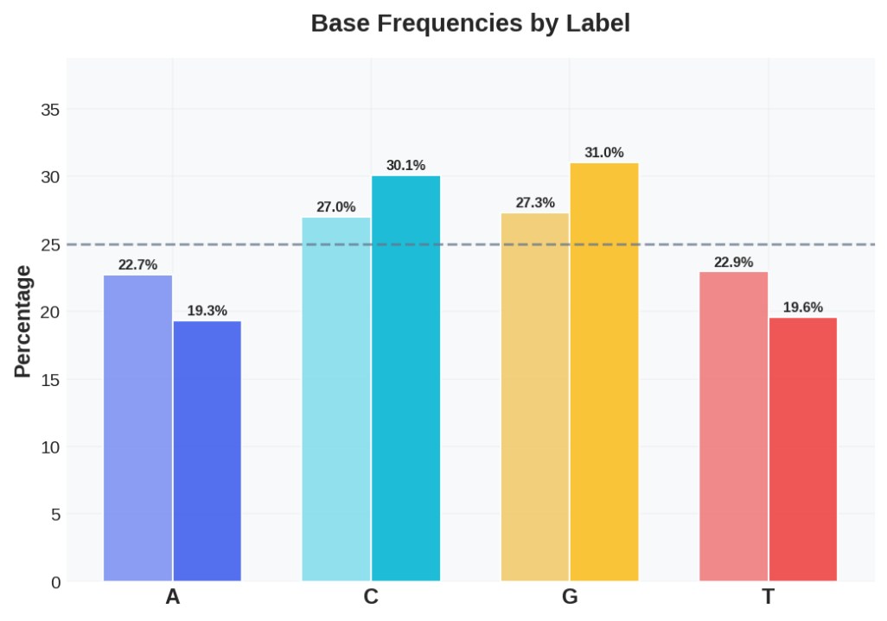
Dataset comparison: composition at unigram level
PRETRAINING: HG38
TASK 1:
Enhancer
TASK 2:
Promoter
Overall base composition
Insights: Regular human genome is A/T rich (not uniformly distributed).
A trivial model that learns base frequencies can do better than random guessing.
Notes:
The regular human genome is A-T rich (not uniformly distributed). If the bases were independently sampled at random, each occur about ~25% of the time - a trivial model that learns base frequencies can do better than random guessing.
For the eval datasets, plots are for the test samples; lighter colour is Y=0; darker for Y=1

Slide 6
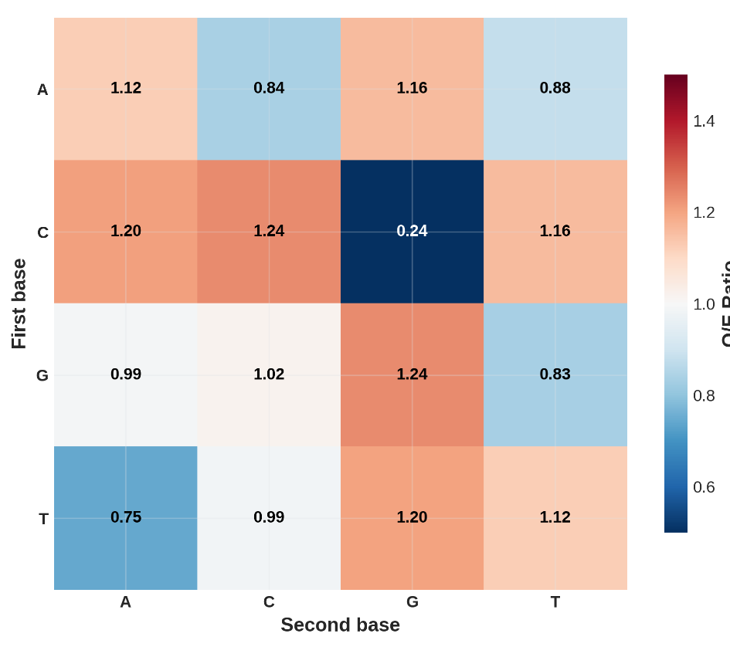
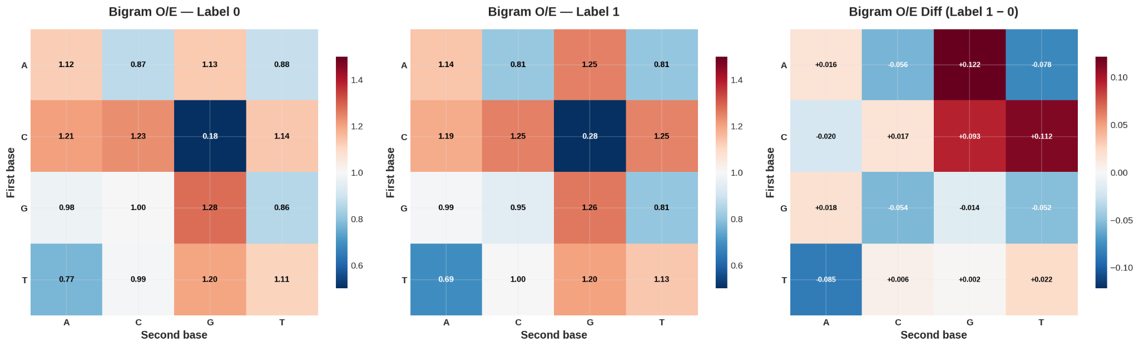
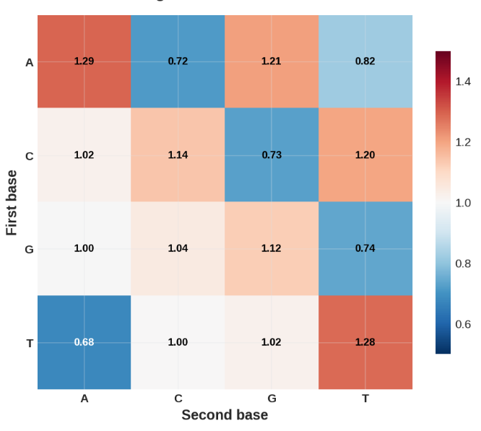
Dataset comparison: composition at bigram level
PRETRAINING: HG38
TASK 1:
Enhancer
TASK 2:
Promoter
Bigram
Observed/
Expected
(O/E)
Insights: O/E ≠0 ⇒ bases are not independent, justifying a sequence model.
Heatmaps share ~ structure across datasets, promoter seq show highest deviation.
Notes:
The regular human genome is A-T rich (not uniformly distributed). If the bases were independently sampled at random, each occur about ~25% of the time - a trivial model that learns base frequencies can do better than random guessing.
Heatmaps are similar across datasets → HG38 pretraining captures shared DNA structure. But classification signal lies in subtle deviations from this shared background → the model must learn fine-grained patterns beyond general DNA statistics.
For the eval datasets, plots are for the test samples; lighter colour is Y=0; darker for Y=1
- For 2nd row, plots are for Y=1 only, I also have plots of the difference if needed
2nd metric Shows how much learnable structure exists beyond single-base frequencies (this may fit better in comparison with the promoter dataset - since promoter sites have more CG clusters)

Slide 7
Timeline
Finetune on Downstream Benchmarks
Finetune on different datasets using weights pretrained on HG38
Examine if better perplexity on HG38 directly leads to universally better genome understanding
Explore Datasets
We discussed about multiple genome datasets: HG38, Enhancer, and Promoter
Final Report
Baselines
Proposal and Data Exploration
Additional Metrics
Pretrain on HG38
Train multiple models with different architectures, and observe their perplexity
Consolidate Experimental Results
Write a technical report with all experimental results, and share our observations

